Slide 1
Bowen Family Systems Theory
&
Affair Recovery

Slide 2
Welcome
Introductions
A Couple of Quick Polls
Text MKNERR650 to 22333 to Join
Then answer the questions….
Notes:
9:45 Start
Welcome
Introduce Myself –
Introduce Key People
Charlie; Cassandra
Heather?
Rikki?
CSWMFT Board Members?
Other Faculty
Thanks – Charlie, Suzanne
Going to Start the Day with a couple of Quick Polls
Pull out your phone – Text this to join, then you can answer the first 3 poll questions; save the others for later
This is to help us all get a sense of where we are as we start thinking about Affair recovery. Look at each briefly – Make observations… Q & A as we go

Slide 3
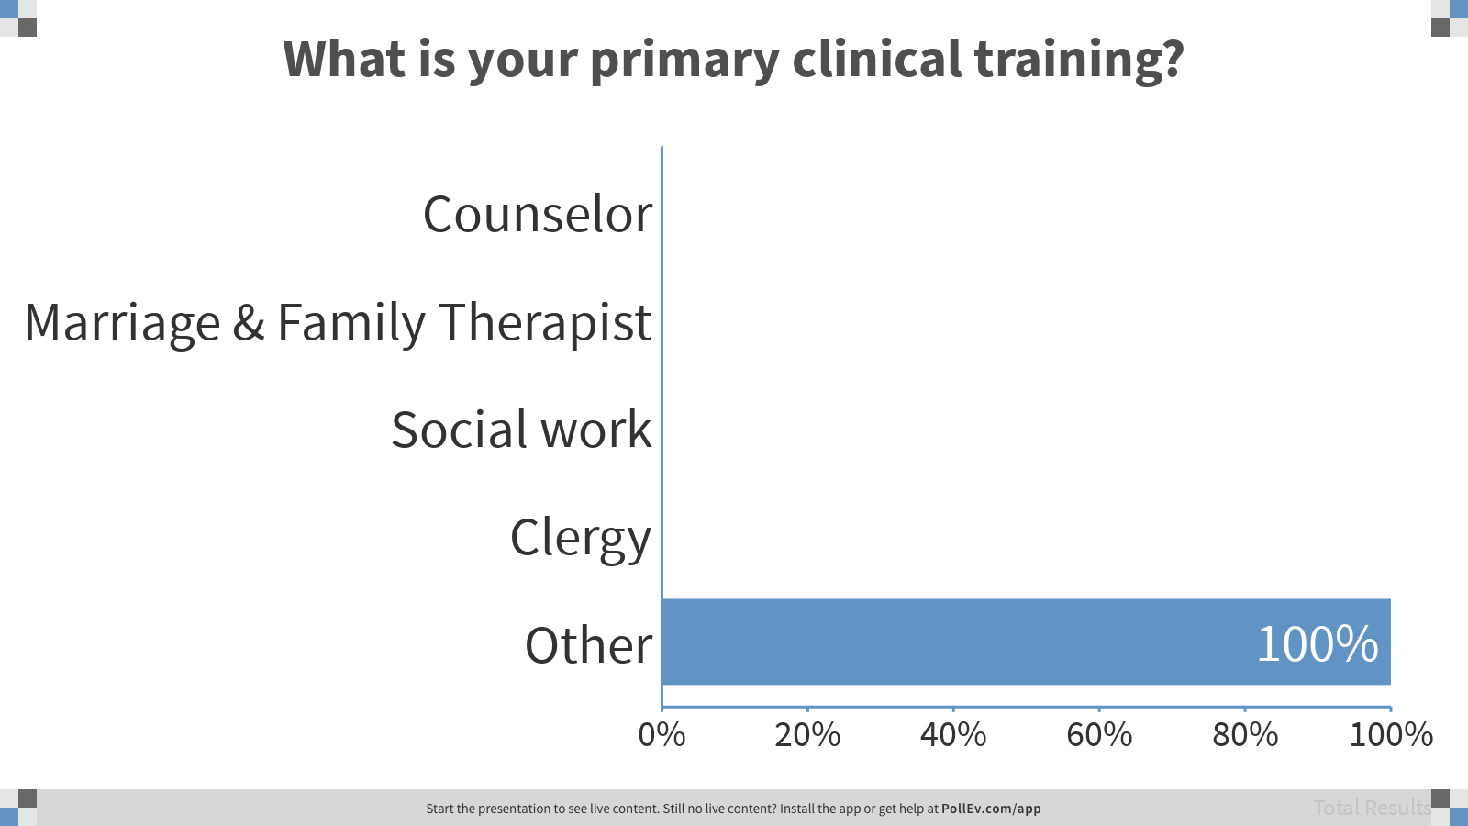
Notes:
Poll Title: What is your primary clinical training?
https://www.polleverywhere.com/multiple_choice_polls/dbfIScQchWwbEmw5oTne3

Slide 4
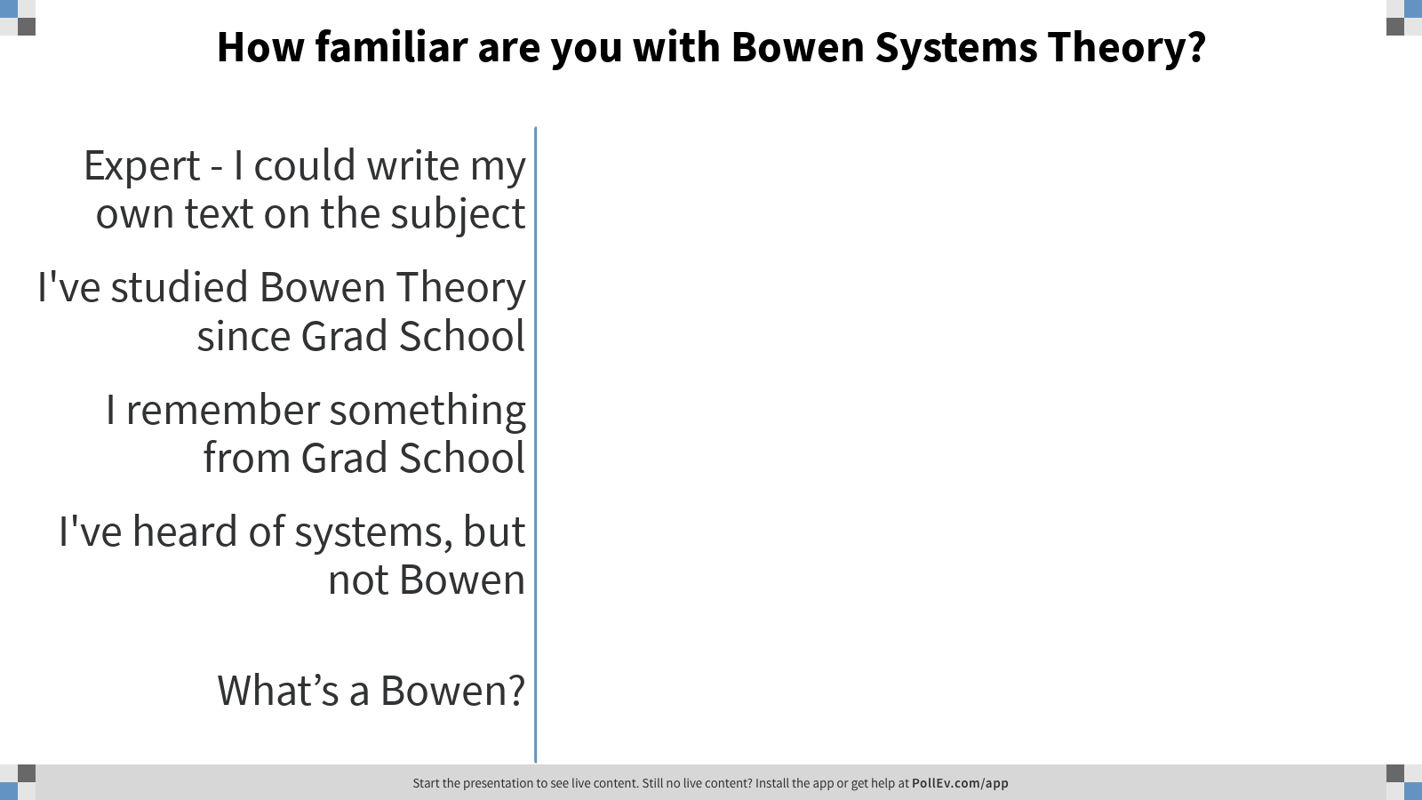
Notes:
Poll Title: How familiar are you with Bowen Systems Theory?
https://www.polleverywhere.com/multiple_choice_polls/utNscNUeidk6hrBE9ZOb6

Slide 5
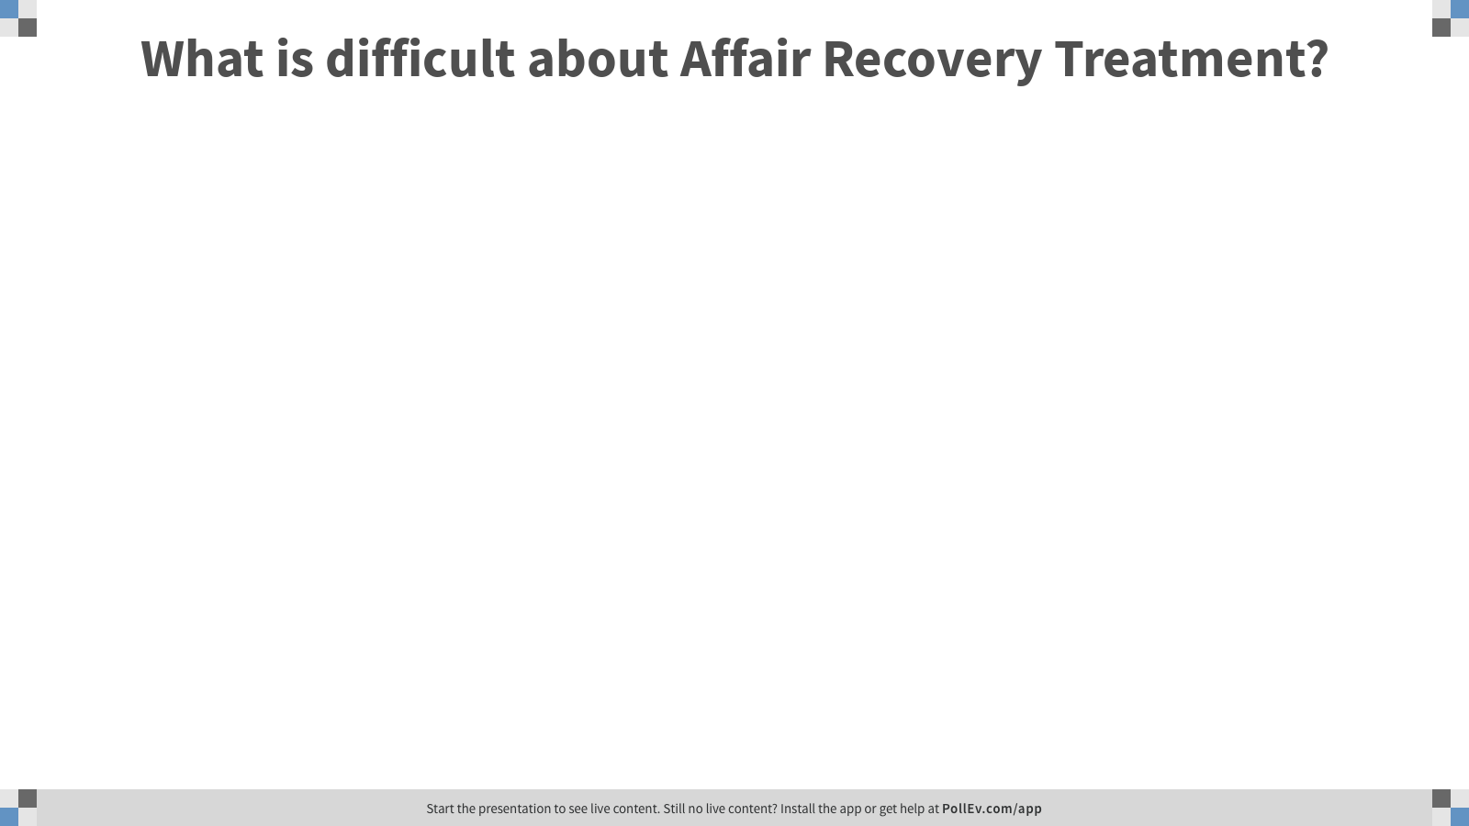
Notes:
Poll Title: What do you find difficult about Affair Recovery Treatment?
https://www.polleverywhere.com/free_text_polls/xPcAVJPMibwdSHN7K3Seb

Slide 6
Structure of Our Time Together
Systems Theory | Bowen Theory | Affair Recovery
Theory >> Practice
Groups of 4
Notes:
Here is some of how I hope we can spend our time today
First half focus on some theoretical issues (some review/some new)
Systems Theory Concepts
Bowen Theory Concepts
Specific Issues with Affair Recovery
Second half of the time – a chance to learn via doing
Groups of 4 – Go ahead and Find a Group
Try to include someone you do not already know in your group

Slide 7
Systems Theory | Bowen Theory | Affair Recovery
What is a System?
Notes:
10:00 Start
Let’s start at the Start – What is a System? How do we apply Systems Concepts to Couples?
What do you think of this description?

Slide 8
Systems Theory | Bowen Theory | Affair Recovery
Homeostasis
Feedback Loops
‘Cannot Not Communicate’
Circular Causality
Notes:
Want to Highlight 4 Systems Theory Concepts
Could spend the whole time on this
Homeostasis – A system seeks stability (stasis)
Relational Systems also do this because constant change is distressing. Imagine if everyday you had to make every decision over for the first time – should I eat? Wear pants? Change jobs? Drive my car?
Relational systems have built in need for change (Developmental/Growth) – challenges Homeostasis
Feedback Loops – a way to maintain stability or challenge it (always interdependent)
‘Cannot Not Communicate’ – Everything (words/actions) communicates, even refusal to communicate
Circular Causality – No single cause/source to fix, causality is multiple and looped

Slide 9
Systems Theory | Bowen Theory | Affair Recovery
Eight Interlocking Concepts
Differentiation of Self
Triangles
Nuclear Family Emotional Process
Family Projection Process
Emotional Cutoff
Multigenerational Transmission Process
Sibling Position
Societal Emotional Process
(The Bowen Center, 2019) https://thebowencenter.org/theory/
Notes:
Start 10:15
Broad Theory of Human Relationships
Medical Training in Biological Systems; Psychoanalysis
8 Concepts – Listed Here, Conceptually not a list; ‘Interlocking’ – cannot describe one concepts without considering connections to the other concepts
Bowen sees Individuals as ‘their own system’ which is interconnected with others via ‘emotional system’ (Emotional = relational)
Brief Description of each Concept

Slide 10
Systems Theory | Bowen Theory | Affair Recovery
Differentiation
Well-Defined Self Genuine Connection
Conscious Choices
It’s All About Me It’s All About You
Reactive Responses
Notes:
Differentiation
Focal Point – primary concept that describes differences in outcomes
Two sided construct
Internal Axis – Reactive Responses (Low) to Thoughtful Choices (High)
Rooted in Brain development – Thinking Fast and Slow
External Axis – Where do you end and I begin? Can also think Venn Diagram circles
Differentiation is not so much about ‘separation’ as definition…. Reactivity/Choice
You/Me
Overlay this with competing goals – wanting two good things that clash
Chronic Anxiety
High Diff – manage these factors, well defined = better prepared for life challenges
Low Diff – captive to the factors, poorly defined = at the mercy of life challenges

Slide 11
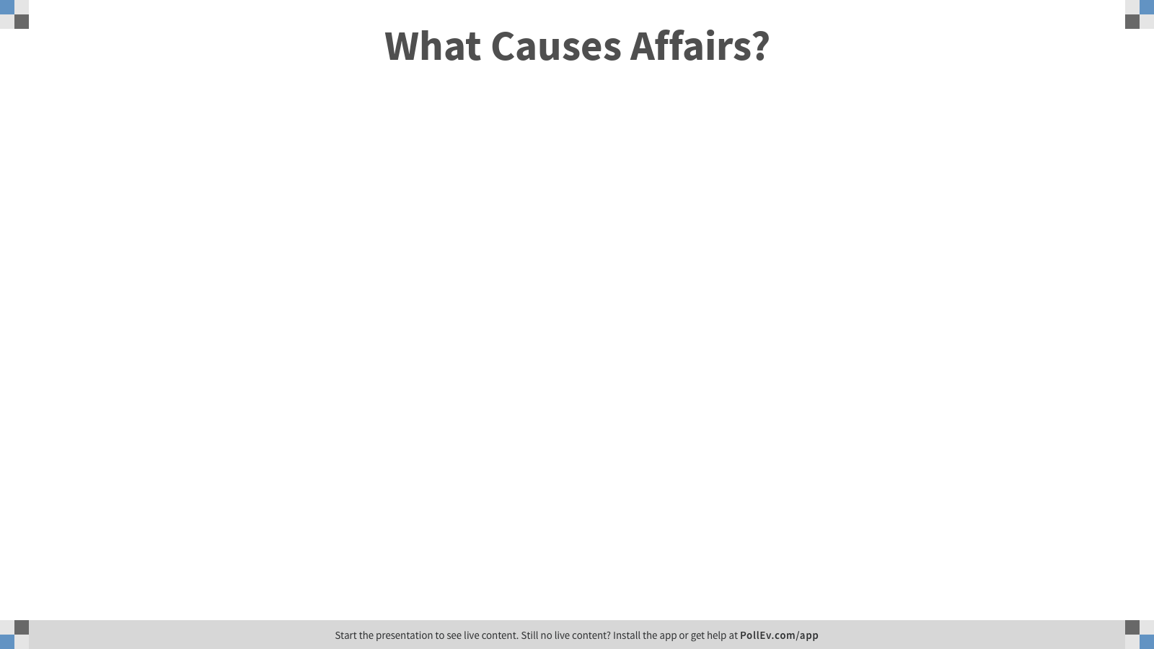
Systems Theory | Bowen Theory | Affair Recovery
Notes:
Poll Title: What Causes Affairs?
https://www.polleverywhere.com/free_text_polls/pICCAX1Ai4tV0ULGZShnu

Slide 12
Systems Theory | Bowen Theory | Affair Recovery
Moral Problem >>>>>>>>>>>>>>>>>>>>>>>>>>>>>>>>> Focus on Forgiveness
Behavioral Problem >>>>>>>>>>>>>>>>>>>>>>>>> Focus on Behavior Modification
Systemic Problem >>>>>>>>>>>>>>>>>>>>>>>> Focus on Couple System Change
YES!
Notes:
Start 10:30
Review Poll Answers
How we conceptualize shapes how we see change
What are pros/ cons of each view of affairs?
Moral – Forgiveness focus
Behavioral – Behavior Modification/Monitoring
Systemic – Symptom of Couple System; change to system needed
Bowen Theory attempts to include all 3 levels
Individual Reactivity (moral)
Behavioral (patterned interactions; habits to change)
Systemic (circularity over linear problem)

Slide 13
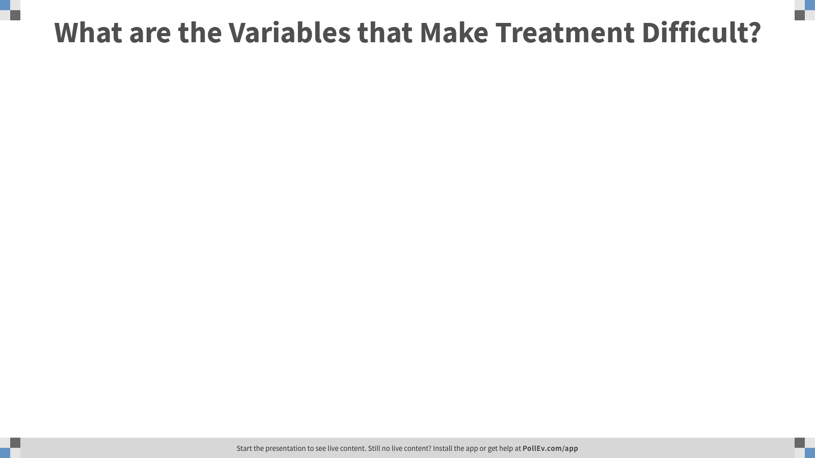
Systems Theory | Bowen Theory | Affair Recovery
Notes:
Poll Title: What are the Variables that Make Affair Recovery Treatment Difficult?
https://www.polleverywhere.com/free_text_polls/lOiLvjUNDwJbp1fu9ZkCy

Slide 14
Systems Theory | Bowen Theory | Affair Recovery
Group Discussions
Four Practice Sessions – Everyone Gets to Try Each Role Once
Partner 1 – Takes the Role of the Affair Partner
Partner 2 – Takes the Role of the Betrayed Partner
Therapist – Leads part of a session
Observer – Watches and Reports Observations
Notes:
Start 10:45
Time to Learn by Doing – Enough Listening
Everyone gets a chance at each role
Organize Groups – Hand out Partner Faces
Partner 1 = Affair
Partner 2 = Betrayed
Therapist
Observer

Slide 15
Systems Theory | Bowen Theory | Affair Recovery
Practice Session # 1
Partner 1 -------(m.2009)-------------Partner 2
Affair Discovered in the past 48 hours – Partner 2 picked up Partner 1’s Phone; By Request of Partner 1; Discovered Explicit Text from Recognizable Co-Worker
Partner 1 – Works as an Employment Attorney, Affair with a Co-Worker, Began Approx. 1 year Ago
Partner 2 – Works as a High School Math Teacher, No Prior Suspicion of Affairs, Complete Surprise
.
9
6
Notes:
Intro the Couple and Affair Details
This is Session #1
Welcomed; Consents Signed

Slide 16
Systems Theory | Bowen Theory | Affair Recovery
Practice Session # 1
Using Bowen Systems Concepts
Therapist - Goal : ‘Should they be in Couple’s Therapy?
Observer: Yes or No Couple’s Therapy?
Notes:
Goal of Session – Assess and Decide: Should they be in Couple Therapy?
Observer – Watch for Evidence Yes/No; Report and Lead Discussion
5-10 minutes till I say Stop
Observers – Discuss Small/Large Group

Slide 17

Systems Theory | Bowen Theory | Affair Recovery
Practice Session # 1
Discernment Counseling – Counseling to Decide: What Should We Do?
Path 1 – Status Quo
Path 2 – Separated/Divorced
Path 3 – Couples Therapy
https://discernmentcounseling.com/
Notes:
Debrief Practice # 1
How to Decide?
What is Couple Therapy?
Just Because they ask for it, are we obligated to provide it?
Discernment Counseling – A step by step protocol to ‘Decide what we are here for’
Know what you sign up for, just makes sense

Slide 18
Systems Theory | Bowen Theory | Affair Recovery
Practice Session # 2
Brief Individual Sessions with Each Partner
Partner 1 – Come see me
Partner 2 -
Therapist – What is each partner thinking about couple’s therapy?
Observer – What did you see? What should happen next?
Notes:
Start 11:00
Next Session – Split the time in half, some with each alone before back together
Rotate Roles – If you are now Partner 1, Come see me
Individual Session – With Partner 1
With Partner 2
How will you handle the new information?

Slide 19
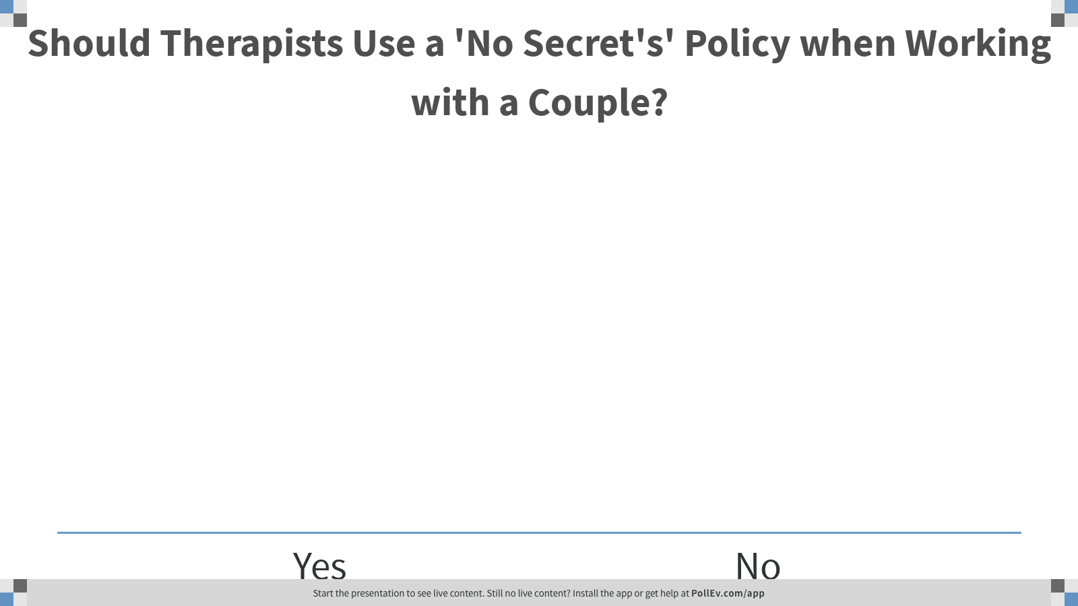
Systems Theory | Bowen Theory | Affair Recovery
Notes:
Pros and Cons of the Policy approach?

Slide 20
Systems Theory | Bowen Theory | Affair Recovery
Practice Session # 3
cvc
cvcc
The more Partner 1 is at work; the more Partner 2 becomes angry
The more Partner 2 is Angry; The more Partner 1 avoids talking with Partner 2
cvcc
cvcc
The more Partner 1 is monitored; The more Partner 1 avoids home and stays at work
The more Partner 1 avoids Partner 2; The more Partner 2 monitors Partner 1
Notes:
Start 11:15
Agreed to Couple Therapy – Session 8
Committed to 6 months Therapy – no discussion of divorce/separation; focus on ‘own work’ to change couple system
Current Circular Hypothesis

Slide 21
Systems Theory | Bowen Theory | Affair Recovery
Practice Session # 3
Couple Agreed to Therapy - 6 Months No Discussion of Divorce
Focus on Own Work - Session # 10
Partner 1 Work = Increase Initiative/Decrease Avoidance
Partner 2 Work = Decrease Reactive Anger/Increase Curiosity
Partner 1 –
Partner 2 – Come See Me
Therapist – Focus time on ‘work’ of Partner 1 in System
Observer – What would increasing differentiation look like? Possible Homework?
Notes:
Rotate Roles
Partner 2’s come see me
Therapist focus at the moment = Work of Partner 1 in System
Observer – Think about ‘differentiation’ looks like in both Partners; Possible Homework?

Slide 22
Systems Theory | Bowen Theory | Affair Recovery
Practice Session # 4
Couple Agreed to Therapy - 6 Months No Discussion of Divorce
Focus on Own Work - Session # 12
Partner 1 Work = Increase Initiative/Decrease Avoidance
Partner 2 Work = Decrease Reactive Anger/Increase Curiosity
Partner 1 – Come See Me
Partner 2 –
Therapist – Focus time on ‘work’ of Partner 2 in System
Observer – What would increasing differentiation look like? Possible Homework?
Notes:
Start 11:30
Rotate Roles again
Partner 1 – come see me
Therapist focus on the work of Partner 2 – what did you learn from previous session
Observer – How to help partners increase differentiation in the session – in real time

Slide 23
References
Brown, J. (2012). Growing Yourself Up. Chatswood, Australia: Exisle Publishing
Bowen, M. (1978). Family therapy in clinical practice. New York: Jason Aaronson.
Doherty, W. J., Harris, S. M., & Wilde, J. L. (2015). Discernment Counseling for ‘Mixed-Agenda’ Couples. Journal of Marital and Family Therapy 42(2): 246–255
Doherty, W. J., & Harris, S. M. (2017). Helping Couples on the Brink of Divorce: Discernment Counseling for Troubled Relationships. Washington, D. C.: American Psychological Association.
Friedman, E.H. (1991). Bowen theory and therapy. In A.S. Gurman & D.P. Kniskern (Eds.) Handbook of family therapy: VII. (pp. 134-170). New York: Brunner Mazel.
Glass, S.P. & Staeheli, J. C. (2003). Not ‘Just Friends’: Rebuilding Trust and Recovering Your Sanity After Infidelity. New York: Simon and Schuster.
Guerin, P.J., Fogarty, T.F., Fay, L.F.,& Kautto, J.G. (1996). Working with relationship triangles. New York, NY: Guilford Press.
Kerr, M.E., & Bowen, M. (1988). Family evaluation. New York: W.W. Norton & Co.

Slide 24
References
Kerr, M. (2019). Bowen Theory’s Secrets. New York: W.W. Norton.
Schnarch, D.M. (1991). Constructing the sexual crucible: An integration of sexual and marital therapy. New York: Norton.
Titelman, P. (2003). Emotional cutoff: Bowen family systems theory perspectives. Haworth Press, New York, NY, US.
Spring, J. A., & Spring, M. S. (2012). After the Affair. New York: Harper Collins.
Thomas, K. W. (2015). Conscious Uncoupling: Five Steps to Living Happily Even After. New York: Penguin Random House.
AAMFT Ethics Code - https://www.aamft.org/Legal_Ethics/Code_of_Ethics.aspx
Discernment Counseling https://discernmentcounseling.com/
Ohio Divorce Laws - Chapter 3105: DIVORCE, ALIMONY, ANNULMENT, DISSOLUTION OF MARRIAGE http://codes.ohio.gov/orc/3105
Second Saturday - https://www.secondsaturdaycolumbus.com/

Slide 25
THANK YOU
Michael Knerr, Ph.D., IMFT-S mknerr@NCU.edu

