Slide 1
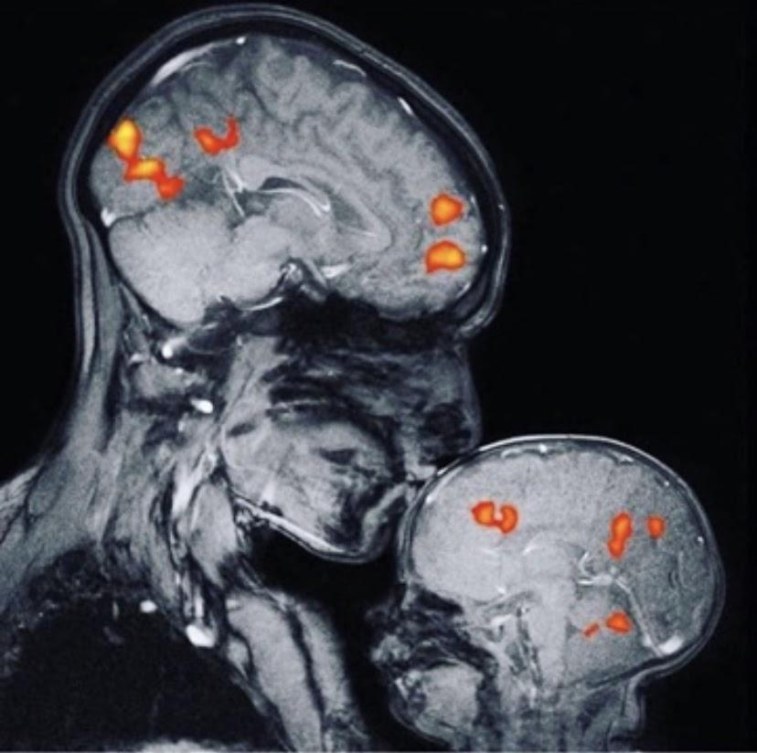
Ohio MFT & Systems Counselor Conference February 22, 2020
Filial Play Therapy (and Child Centered Play Therapy)
Julia Copley, LSC, LPCC, RPT

Slide 2
What is Filial Play Therapy?
...A therapeutic intervention to promote parent-child interaction and improve child’s behavior across culture.
Van Fleet article
Training by Van Fleet: http://www.play-therapy.com/workshops_ift.html

Slide 3
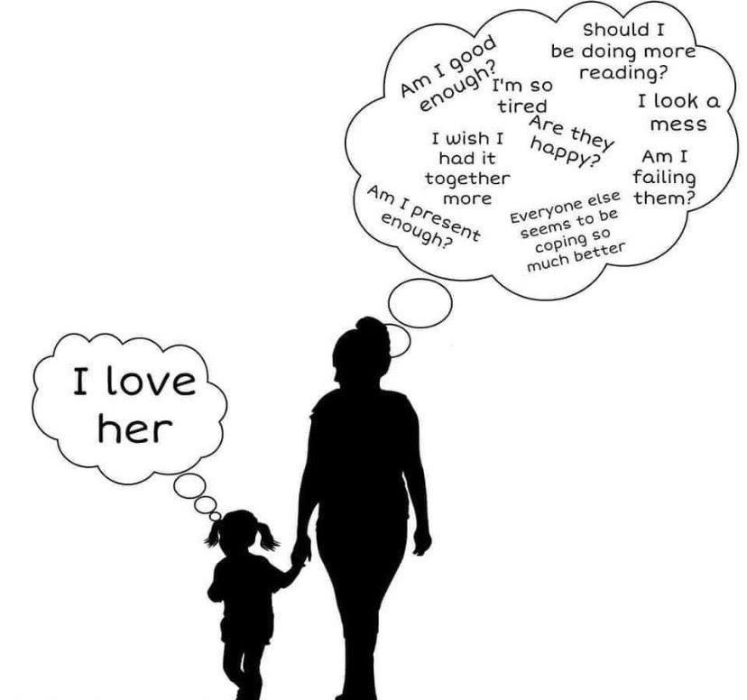

Slide 4
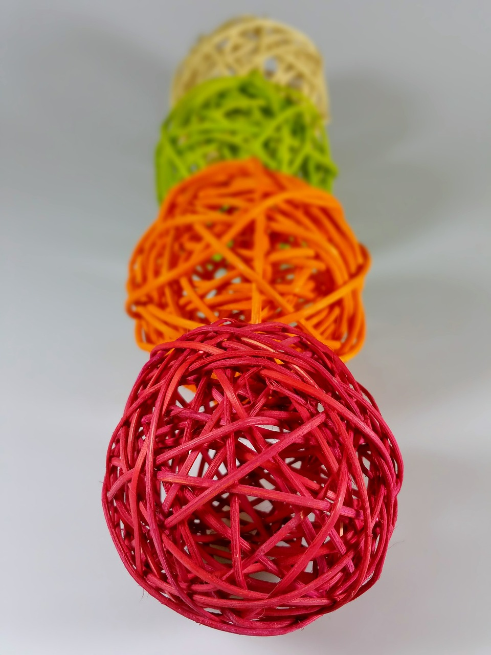
Activity
“I’ve Got You”

Slide 5
Why Filial Therapy?
Parents misinterpret the child’s message
Emotional needs are not met
The gap between parent and child increase daily
Play is the language of the child to which parents can use to connect with their child

Slide 6
Activity:
Mirroring
Ho Ro Mo Nighean Donn Bhoidheach
By: The Rankin Family

Slide 7
Essentials:
Parent learns to focus exclusively on the child
Child gets to lead the play
Parents becomes neutral narrator
Parents learn to set limits on child’s behavior

Slide 8
Activity
Get a Ball!
Boundaries - Parent
Decisions - Child
Narrate - Parent

Slide 9
Learn More:
https://www.counseling.org/docs/default-source/vistas/filial-therapy-an-attachment-based-emotion-focused-and-skill.pdf?sfvrsn=dedfaa57_12
Filial Therapy: An Attachment Based, Emotion Focused, and Skill Training Approach Paper based on a program presented at the 2012 American Counseling Association Conference, March 23, 2012, San Francisco, CA. Barry G. Ginsberg

Slide 10
Activity
“Dream With Me”
1-2 sessions
Child
Title of your dream
Feelings you had in your dream
What you noticed in your dream
Tell me what happened (present tense/”as if it is happening right now”

Slide 11
Activity
“Dream With Me”
Family: just listening and observing
Child:
Decides who will play who/what in the dream
Props
Child directs the dream
Child can change the dream’s ending
Family does exactly as child instructs without question

Slide 12
Activity
“Dream With Me”
After re-enactment is completed:
To Child/Director:
? What was this like for you?
? What did you like the best?
? Was there anything you did not like or wish was different?
?What are some of the feelings you had during this activity?

Slide 13
Activity
“Dream With Me”
After re-enactment is completed:
To Family Members/Actors:
? What was this like for you?
? What did you like the best?
? Was there anything you did not like or wish was different?
?What are some of the feelings you had while playing the characters or objects?

Slide 14
